Slide 1

Funny Gorilla 诙猩猩-IT培训
Your success is our success
Software Testing Lifecycle

Slide 2
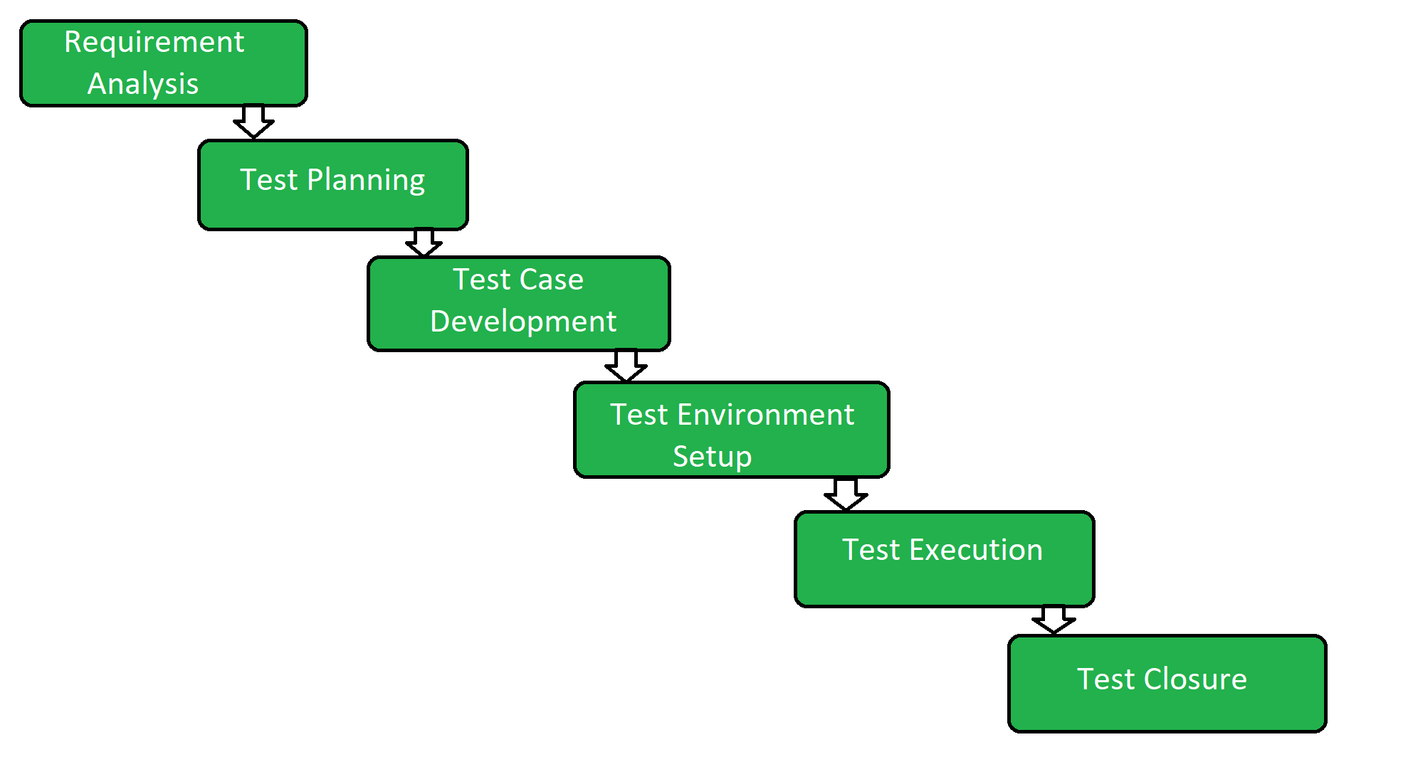

Slide 3
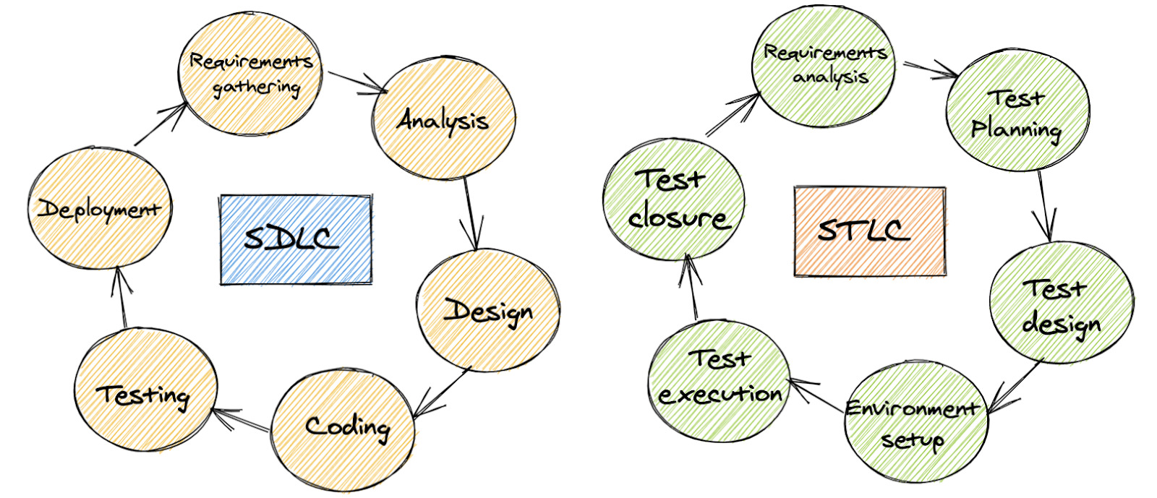
SDLC vs STLC

Slide 4
A set of conditions that testers must satisfy to begin the test.
Entry Criteria
Test
Phrase
Exit Criteria
A set of conditions that testers must satisfy to end the test.

Slide 5
Requirement Analysis
Activities
Identify customer needs and types of tests.
Gather details about requirements.
Prepare Requirement Traceability Matrix (RTM).
Identify test environment details.
Automation feasibility analysis (if required).
Deliverables
Requirement Traceability Matrix (RTM).
Automation feasibility report (if applicable).
Entry Criteria
client requirements,
acceptance criteria, and
intended product architecture to be documented.
Exit Criteria
aim for a requirement traceability matrix (RTM) and
decision of automation.
Notes:
the STLC team understands the requirements 📃
If necessary, the testing teams may also consult with stakeholders to clarify the requirements.
The requirements may be functional or non-functional and
the decision to automate testing is also evaluated at this point.

Slide 6
Test Plan
Activities
Preparation of test plan documents for all types of testing.
Selection of test tools.
Test effort estimation.
Resource planning and deciding roles and responsibilities.
Training requirement.
Deliverables
Test plan document.
Effort estimation document.
Entry Criteria:
Report the implemented test strategy.
Exit Criteria:
Testers should have approval on the test plan’s risks and costs.
Notes:
This phase includes :
implementing and defining a test strategy in the testing plan and
estimating the efforts and costs of the testing team.
This stage commences once requirement gathering is complete.

Slide 7
Test Case Development
Activities
Creation of test cases and automation scripts (if applicable).
Review test cases and scripts.
Create test data (If Test Environment is available).
Deliverables
Test cases/scripts.
Test data.
Entry Criteria:
Approval of timelines to execute the test plan.
Exit Criteria:
Approval of test cases and automation scripts.

Slide 8
Test Environment Setup
Activities
keep the test environment ready by understanding the required architecture, environment setup, and preparing a hardware/software requirement list.
Setup test environment and test data.
Perform a smoke test on the build.
Deliverables
Test Environment ready with the prepared test data.
Smoke Test Results.
Entry Criteria :
Have a defined system design and project architecture.
Exit Criteria:
Have a working QA/Testing environment set up to run test cases.
Notes:
In the fourth phase, a QA/Testing environment is configured and deployed to allow testers to test the feature.
Once the testers deploy the environments, smoke testing may be performed to ensure the environment is working with the intended functionalit

Slide 9
Test Execution
Activities
Execute test cases according to plan.
Generate a test report and log defects for failed cases.
Map defects to test cases in RTM.
Perform Retest.
Track the defects to Complete the test.
Deliverables
Completed RTM with the execution status.
Test cases updated with a pass or fail results.
Defect reports.
Entry Criteria:
Have all the previous steps completed, especially the exit criteria.
Exit Criteria:
Document test execution and results to report them back.
Notes:
In the fifth stage, testers begin the test execution as the environment is successfully set up.
The test cases generated at phase three are put into action here and previously expected results may compare to the actual results as a baseline.
Testers may also report back interesting findings, such as bugs, to the development teams.

Slide 10
Test Closure
Activities
Evaluate test cycle closure completion criteria based on Time, Test coverage, Cost, Software, Critical Business Objectives, and Quality metrics.
Prepare test metrics based on the above parameters.
Prepare Test closure report.
Test result analysis to find out the defect distribution by type and severity.
Deliverables
Test Closure report.
Test metrics.
Entry Criteria:
Test results and logging from the previous phases..
Exit Criteria:
Delivered planned deliverables (delivered planned deliverables use too much of the same word.
Try to add a different one) and approved test closure test summary report
Notes:
In the last stage of the STLC, a test result report is generated.
The report should contain the entire process of testing new requirements such as the analysis between the expected outcome and the actual outcome, whether the objectives were met or not, the time taken to test the feature, costs, test coverage, and if there were any defects and details about it

Slide 11
Reference
https://blog.testproject.io/2020/11/03/software-testing-life-cycle-stlc/
https://www.lambdatest.com/blog/software-testing-life-cycle/

Slide 12
Testing Life:
Unit Testing -------- PVT

Slide 13

Contact
Your success is our success
Mail: info@funnygorilla.com.au
Linkedin: https://mt.linkedin.com/in/songqing-gu-2ba9034b/de
Web Chat: FunnyGorilla
Phone: 0420891343

